Slide 1
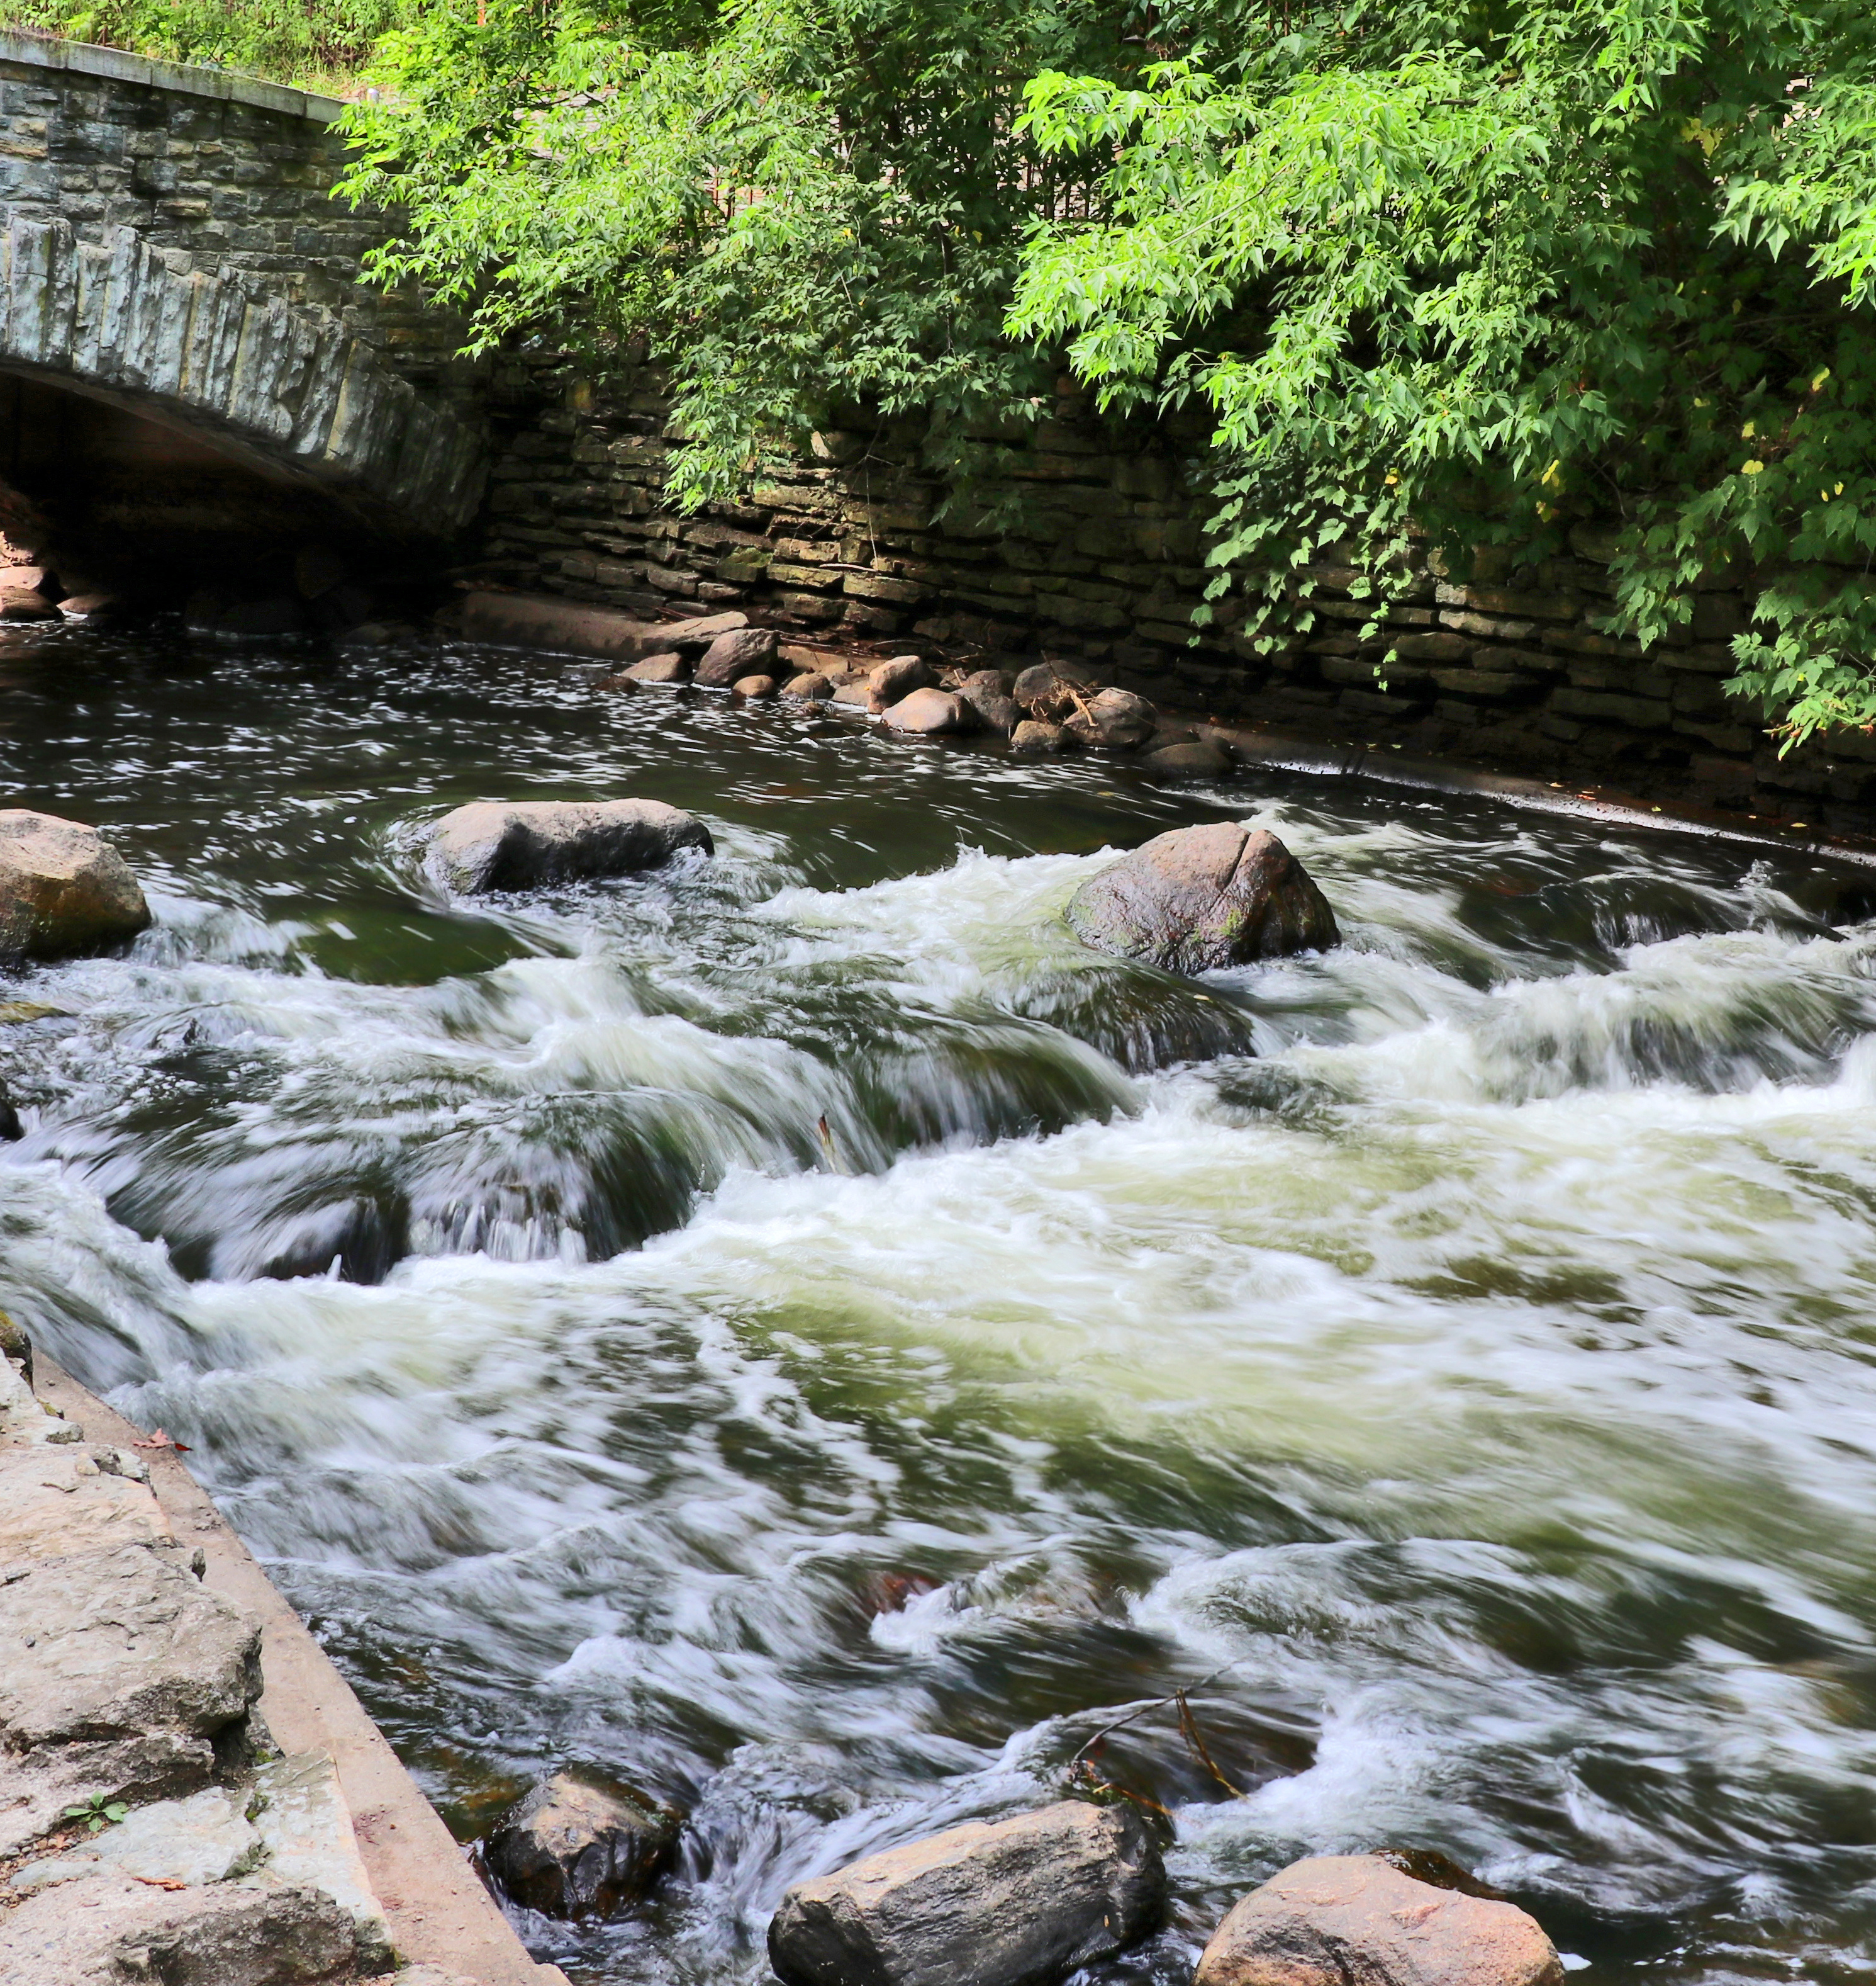

Advancing Equity in Conservation Funding: Lessons from Minnesota and Beyond
Rally 2025: The National Land Conservation Conference
Notes:
Photo credit: Tony Webster, Minneapolis MN. Katharine Ordway Natural History Study Area (Ordway Field Station), owned by Macalester College, on the bluffs of the Mississippi River in Inver Grove Heights, Minnesota, in spring.

Slide 2
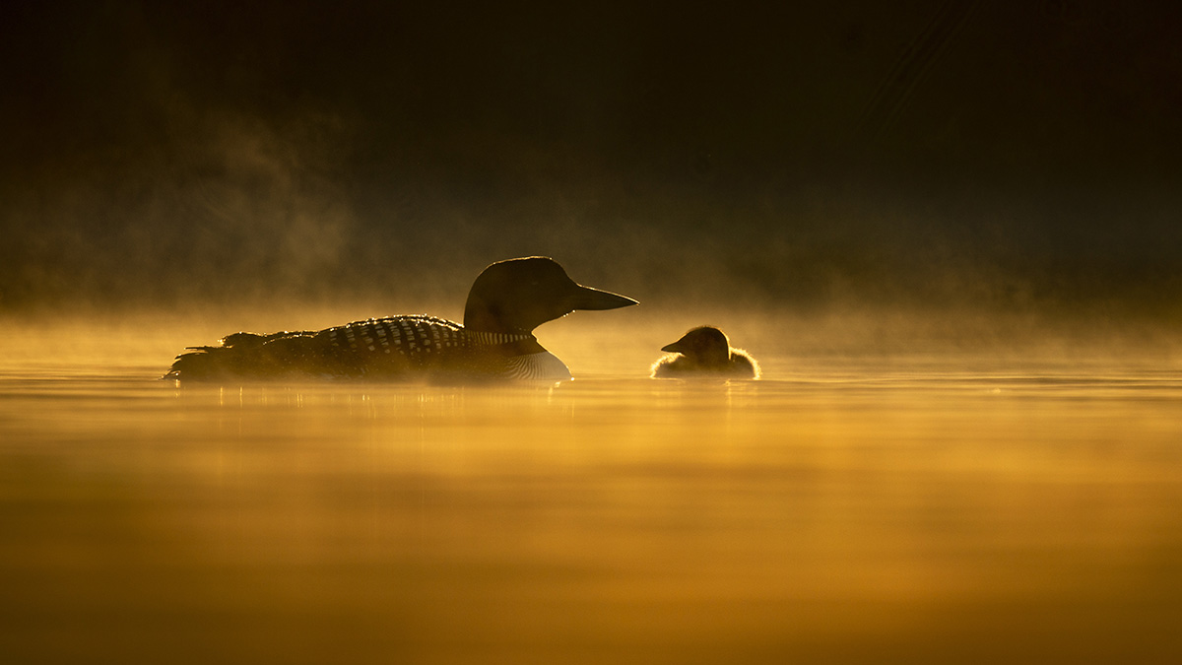
What is the Environment and Natural Resources Trust Fund?
The Environment and Natural Resources Trust Fund has provided approximately $900 million to over 1,700 projects in Minnesota.
Notes:
The Environment and Natural Resources Trust Fund (ENRTF) was established following voter approval of a constitutional amendment in 1988.
Money in the fund is generated by the Minnesota State Lottery.
Funds are to be used for “for the public purpose of protection, conservation, preservation, and enhancement of the state's air, water, land, fish, wildlife, and other natural resources.”
It is a very important long-term secure funding source for conservation and other environmental projects and causes in Minnesota.

Slide 3
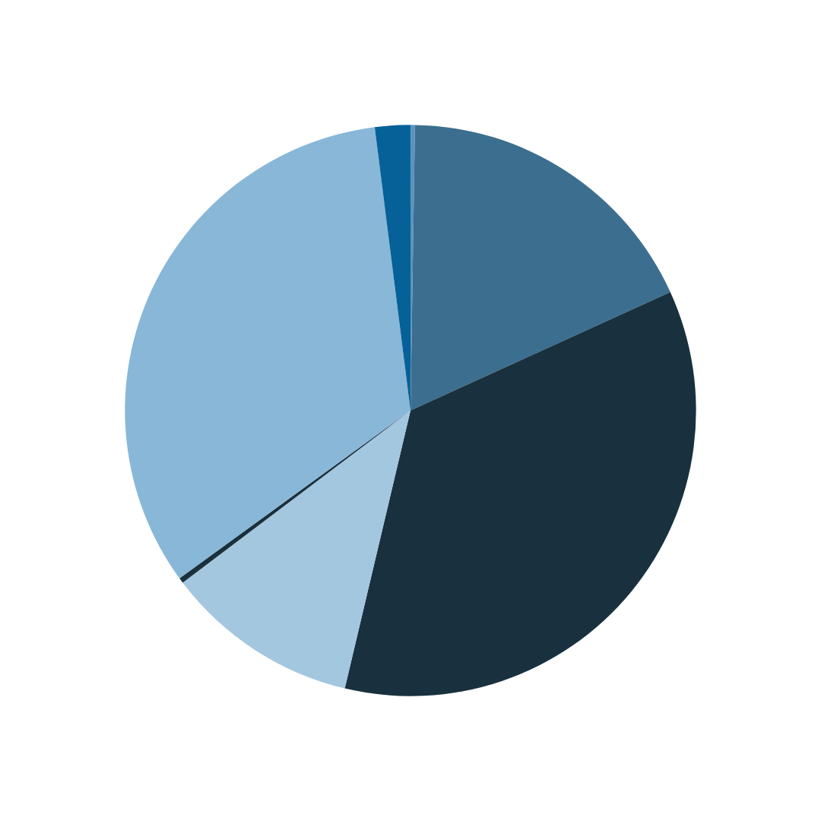
Where do ENRTF funds go?
2% - For-profits
0.3% - Private college/university
17.9% - Nonprofits
32.6% - Public college/university
0.3% - Federal government
35.5% - State government
11.5% - Local/regional government
Source: Legislative-Citizen Commission on Minnesota Resources (2024)
Notes:
As you can see, funding skews towards state agencies and universities.
Nonprofit organizations only secured about 18% of funds in 2024—an increase of about 8% since 2022.
Of those nonprofits funded, many are larger, well-established organizations who employ professional fundraisers and lobbyists.

Slide 4
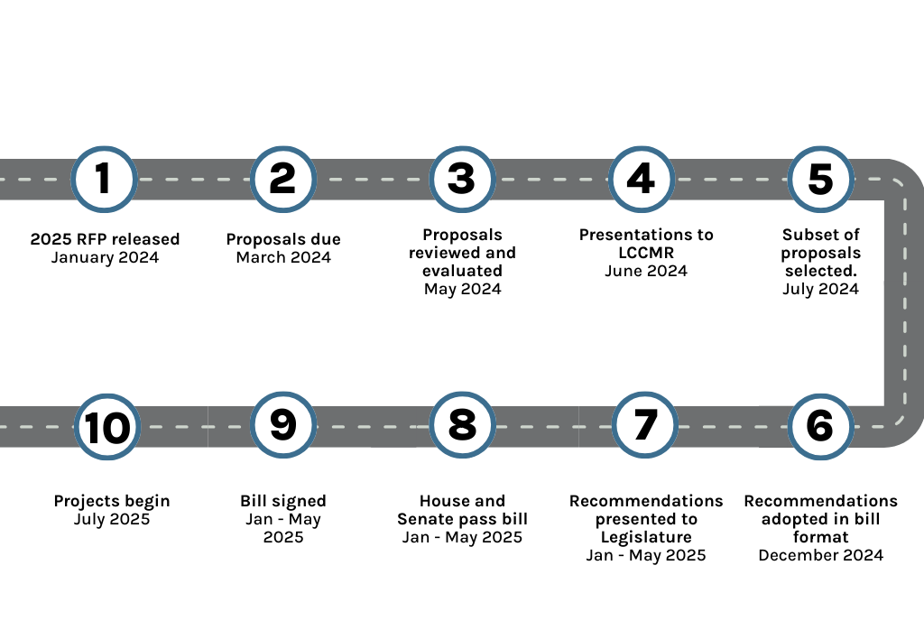
A long, complex process.
2025
Source: https://www.lccmr.mn.gov/proposals/2025/2025_lccmr_rfp.pdf
Notes:
Getting a grant from the Environment and Natural Resources Trust Fund is a roughly 17-month long process.
Grantees must respond to the Request for Proposals.
If you make the initial cut, you must present your proposal to the Legislative-Citizen Commission on Minnesota Resources (LCCMR), a 17 member body of senators, house members, and citizens that makes funding recommendations to the Minnesota Legislature for special environment and natural resource projects.
Just because you present to LCCMR, doesn’t mean you are guaranteed funding.
LCCMR makes another cut following presentations. Only those that are recommended for funding end up in the bill that goes before the Legislature.
Upon passage, the bill goes to the Governor to be signed into law.
As you can imagine, only organizations with the people and infrastructure power to jump through these hoops are the only organizations to apply and secure these funds.
There are structural inequities baked into the current system. https://www.lccmr.mn.gov/proposals/2024/2024_lccmr_rfp.pdf

Slide 5
ENRTF Coalition organizations
Audubon Society
Clean Water Action
Climate Generation
Conservation Minnesota
COPAL
CURE
Ducks Unlimited
Environmental Initiative
Freshwater
Friends of the Mississippi River
Great River Greening
Initiative Foundation
Leech Lake Band of Ojibwe
MN 350
Minnesota Center for Environmental Advocacy
Minnesota Conservation Federation
Minnesota Environmental Partnership
Minnesota Land Trust
Minnesota Raptor Center
Minnesota Valley Trust
National Loon Center
National Wildlife Federation
Northern Water Land Trust
Pheasants Forever
Public Policy Project
Rainbow Research
The Conservation Fund
The Nature Conservancy
The Raptor Center
The Trust for Public Land
Wilderness Inquiry
Wild Rivers Conservancy

Slide 6
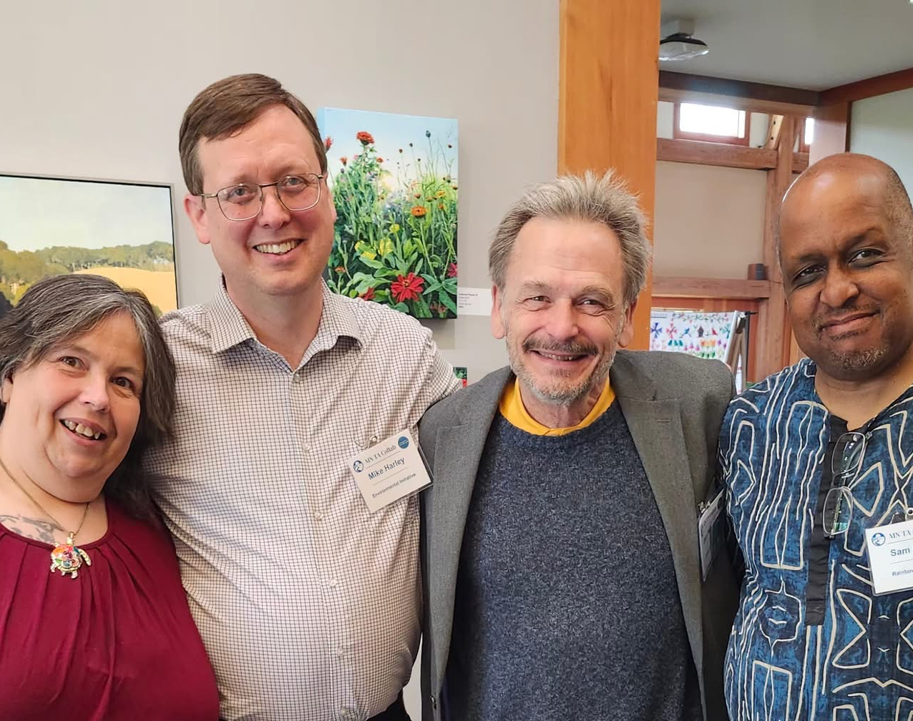
Community Engagement Working Group
Co-led by Rainbow Research and Environmental Initiative.
Environmental justice leaders and mainstream environmental groups.
Focused on engaging communities and supporting design of an inclusive, equitable, and just grant program.
Engaging and collaborating with Minnesota Department of Natural Resources (MNDNR).
Notes:
Environmental justice leaders and mainstream environmental organizations saw an opportunity to enhance how Minnesota’s state lottery dollars are distributed for environmental projects.
They/we advocated for a new community grants program – one that reduces administrative barriers that have made access to ENRTF dollars difficult for black, brown, Indigenous, and rural community members.
The design for the program was led and envisioned by a smaller subgroup of the Coalition, the ENRTF Community Engagement Working Group.
Subgroup members were also involved in educating legislators in partnership with lobbying coalition members.
In 2023, the Minnesota Legislature passed a bill that gave voters an opportunity to renew and enhance the Environment and Natural Resources Trust Fund.
The bill also established a new Community Grants Program, which increases the amount of lottery funds that go towards the environment and creates a more equitable pool of funding.
This group worked to advocate for voters to reauthorize the ENRTF in 2024.
77% of Minnesotans voted "yes." No response is a "no" vote.
In the 2025 Legislative session, proposals were made to divert funding away from the program.
The group wrote letters and attended legislative sessions in support of an unaltered bill.
We are now focused on engaging communities about the new program and supporting the design of the grant program itself.
(This is a good chance to speak about fears/how the collaboration is going.)

Slide 7
ENRTF Community Engagement Working Group members
Paul Austin, Conservation Minnesota
Lindsay Brice, Audubon
Cecilia Calvo, Rainbow Research
Rachel Geissinger, Environmental Initiative
Sam Grant, Rainbow Research
Mike Harley, Environmental Initiative
Jasmine Baxter, Environmental Initiative
Don Hickman, Initiative Foundation
Esther Humphrey, Leech Lake Tribal College
Kartumu King, Accountable Cultural Brokers
Kris Larson, Minnesota Land Trust
Joe Morales, Rainbow Research
Steve Morse, Minnesota Environmental Partnership
Ann Mulholland, The Nature Conservancy
Sharon Nordrum, Red Lake Band Member
Carolina Ortiz, COPAL MN
Nels Paulson, Conservation Minnesota
Stephanie Pinkalla, The Nature Conservancy
Sarah Psick, Psick Capitol Solutions
Rob Schultz, Audubon
James Trice, Public Policy Project
Sophie Vorhoff, Trust for Public Land
Molly Zins, University of Minnesota Extension

Slide 8
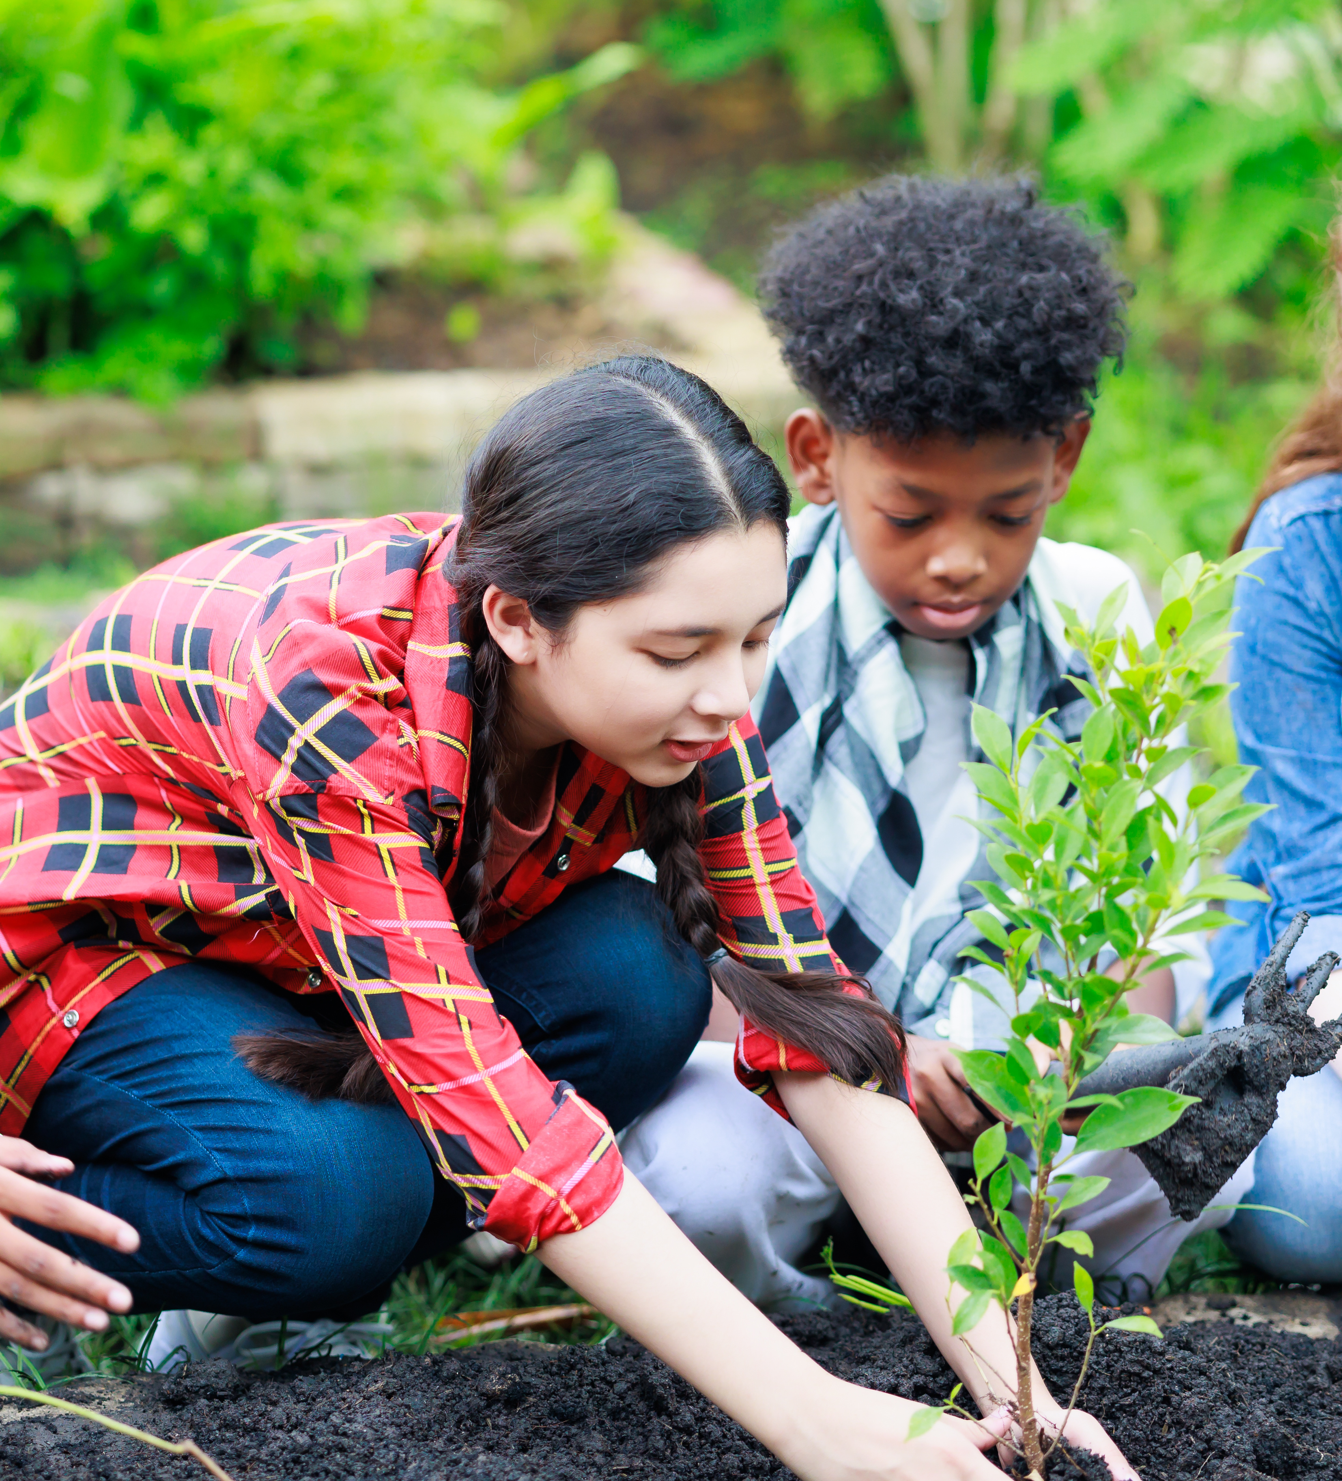
Community grants program details
Sets aside ~ $28 million a year.
Does not replace current ENRTF grant program.
Inclusive and equitable.
Administered by the MNDNR.
Notes:
About $28 million a year will be available for smaller nonprofits, Tribes, and BIPOC-led organizations through the program.
The Community Grants Program won’t replace or compete with the current funding or process.
The goal is for this pool of funding to be more accessible for Minnesotans. A program for communities and organizations historically left out of the ENRTF process.
The community grants program will “expand the number and diversity of recipients who benefit from the ENRTF, especially in communities that have been adversely affected by pollution and environmental degradation.”
DNR will administer the new grant program, meaning organizations will apply to DNR for funds.

Slide 9
Community grants eligible projects
All projects must involve:
Helping adversely impacted communities respond to environmental degradation and related health concerns;
Education and awareness related to stewardship of air, land, water, forests, fish, wildlife, and other natural resources; or
Preserving or enhancing air, land, water, and other natural resources that otherwise may be substantially impaired or destroyed in any area of the state.
Notes:
The community grants program will bring together environmental protection + environmental health.
Community grants eligible projects must involve:
-Helping adversely impacted communities respond to environmental degradation and related health concerns;
-Education and awareness related to stewardship of air, land, water, forests, fish, wildlife, and other natural resources; or
-Preserving or enhancing air, land, water, and other natural resources that otherwise may be substantially impaired or destroyed in any area of the state.
This note is just for my reference:
Examples of possible projects include:
-Monitoring and supporting communities impacted by industrial pollution
-Environment and related health education
-Energy efficiency and weatherization upgrades in low-income communities Investments in parks and greenspace to improve community access and habitat
-Creating pollinator corridors that provide habitat and food to vulnerable species
-Reforestation and restoration that provides habitat and sequesters carbon
-Building forest canopy in cities to reduce the effect of urban heat islands
-Plantings to protect surface and groundwater

